Slide 1
Finance Credit Team Sprint Update 5
November 19th, 2023
Lucas | Kendall | lakendal@mtu.edu
Trent | Magers | tfmagers@mtu.edu
Emily | Wood | Ewood@mtu.edu
Reyn | White | walterw@mtu.edu
Irene | Trierweiler | Iltrierw@mtu.edu
Joseph | Williams | jokwilli@mtu.edu
Atharva | Joshi | atharvaj@mtu.edu
John | Mware | jmware@mtu.edu

Slide 2
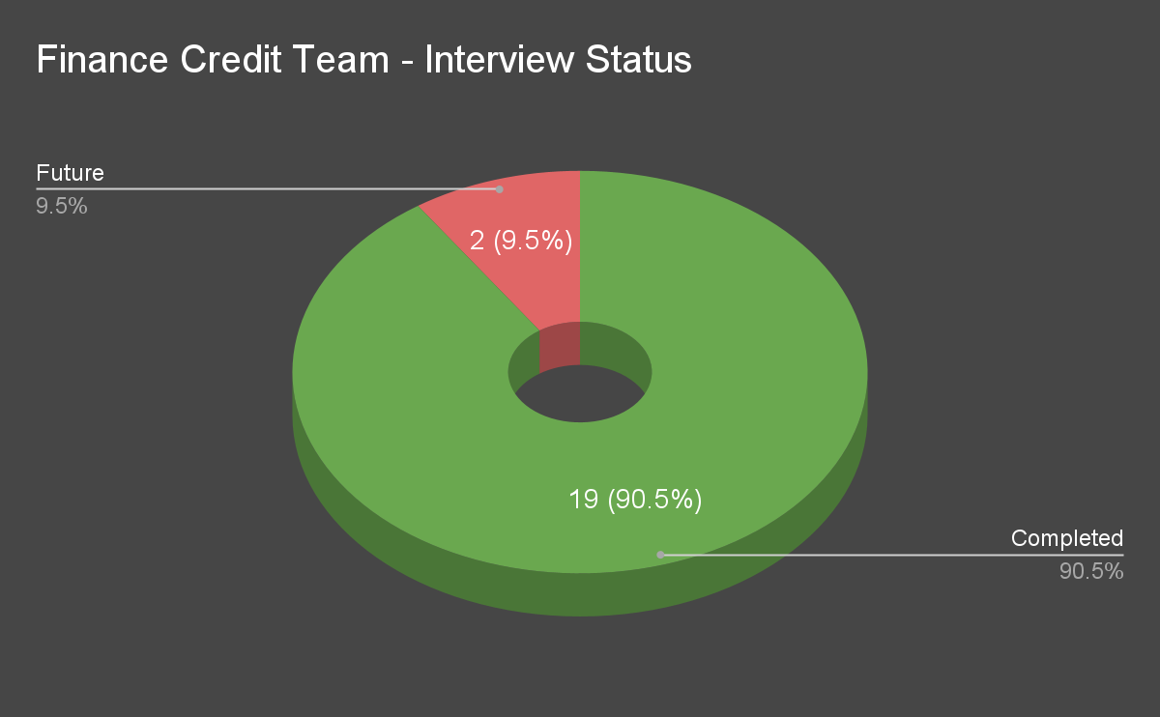
Interviews Status

Slide 3
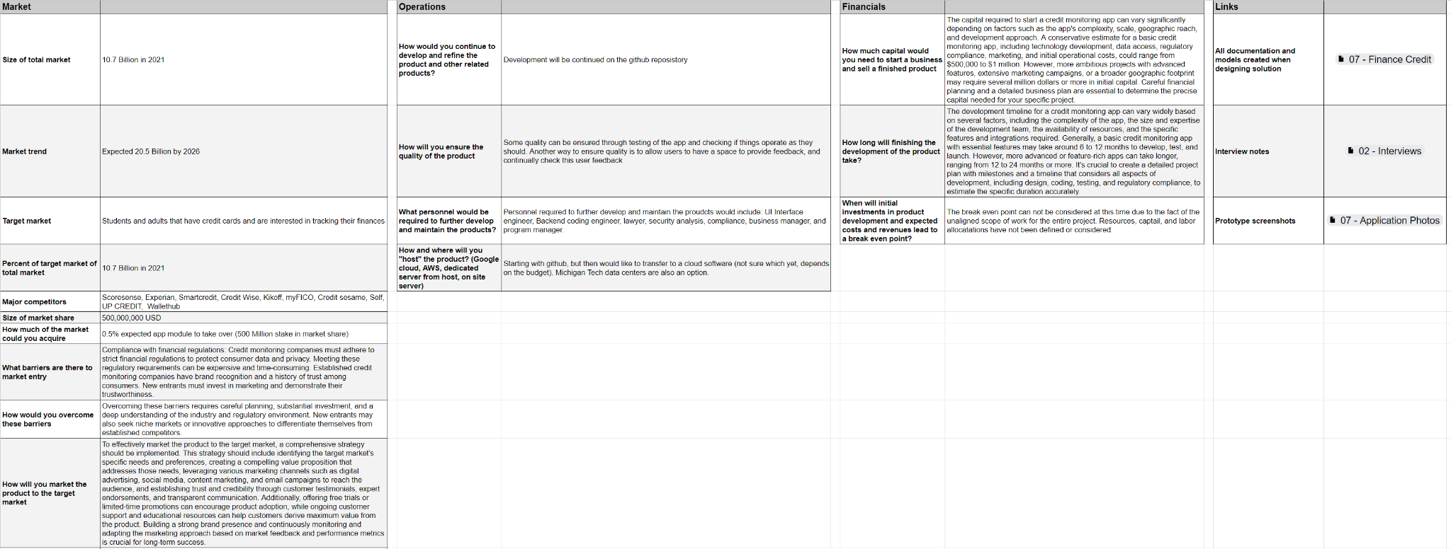
Business Portfolio - Questions

Slide 4

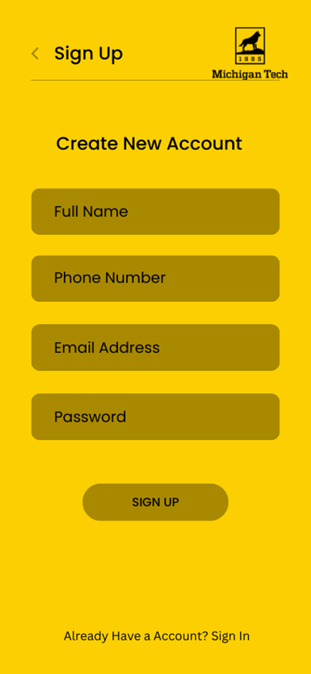
Application Development - Front End

Slide 5
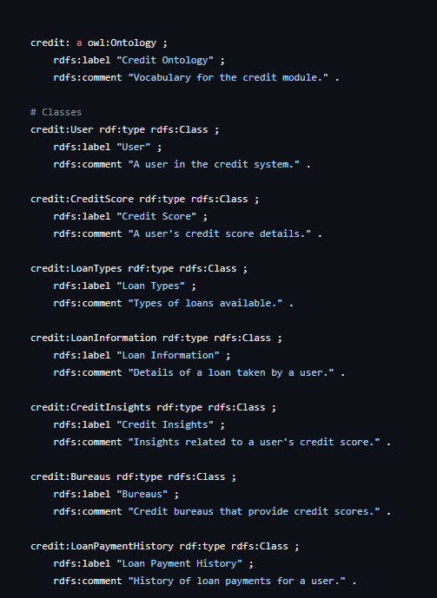
Github Ontology

Slide 6
Steps Moving Forward
Interviews
Finishing last few interviews
Doing additional interviews as necessary
Front End Cross Development
Application web based development.
Business Case Development
Supporting All Business Case Questions.
Github Cleanup
Continuous Improvement on Trello project tracking.

